Slide 1
SAI PRANEETHA THOTAKURA
EMPLOYEE ID: 153041
JAVA FULL STACK, MIPL

Slide 2
CapStore Shopping Application

Slide 3
Project Requirements

Slide 4
Softwares:
Java 10
STS Version: 3.9.4.RELEASE
MySQL 5.5 Command Line Client
HTML 5
Bootstrap
CSS 3
JavaScript
JSP
Spring Boot (2.0.4)
Spring Rest
Notes:
Fixar a posicao do titulo – sempre do lado esquerdo.
Sempre que tiver muito texto o coluna deve sempre ser “ narrowed” , se nao fica dificil de ler. Colocar paragrafos no texto.
Linha vertical deve ser mais fina e as pontas NUNCA devem ser arredondadas.

Slide 5
MODULE
GETTING SHIPPING DETAILS

Slide 6
Getting Shipping details
The customer either clicks on BUY NOW button or PROCEED TO CHECKOUT for the selected product.
Then he/she is navigated to the shipping details page.
The page contains all the addresses of the customer so that they can select from the list of addresses or they can enter an alternate address.
After successful entering of shipping details customer is navigated to payment page
Prior to this, an Shipping Id is auto-generated for the purchased product, which is used for accessing in future.

Slide 7
SHIPPING DETAILS
Attribute Name | Data type | Constraint | Description
shippingId | int | Primary key | Unique
customerId | int | Foreign Key | For accessing customer details
orderId | int | Foreign Key | For accessing order details
addressId | int | Foreign Key | For accessing address details

Slide 8
Tables Used
Customer
customerId
customerName
dateOfBirth
emailId
IsActive
lastLogin
password
phoneNumber
Order
orderId
deliveredDate
deliveryStatus
orderDate
customer
shipping
shippingId
customerId
addressId
orderId
Address
addressId
stNo
city
state
country
zipcode

Slide 9
Screenshots

Slide 10
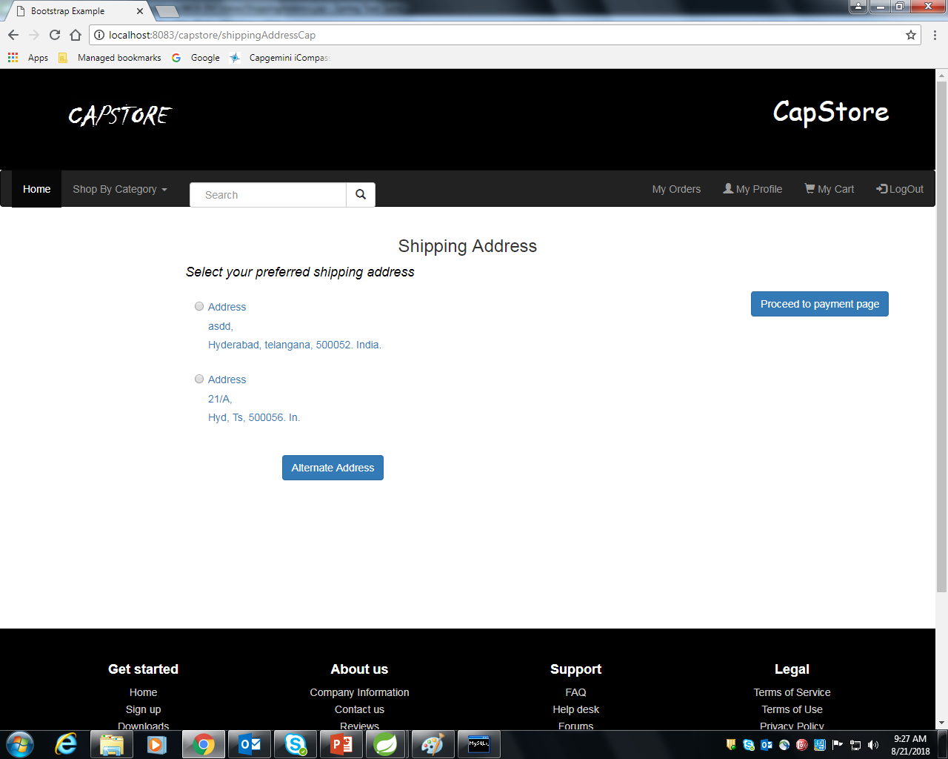

Slide 11
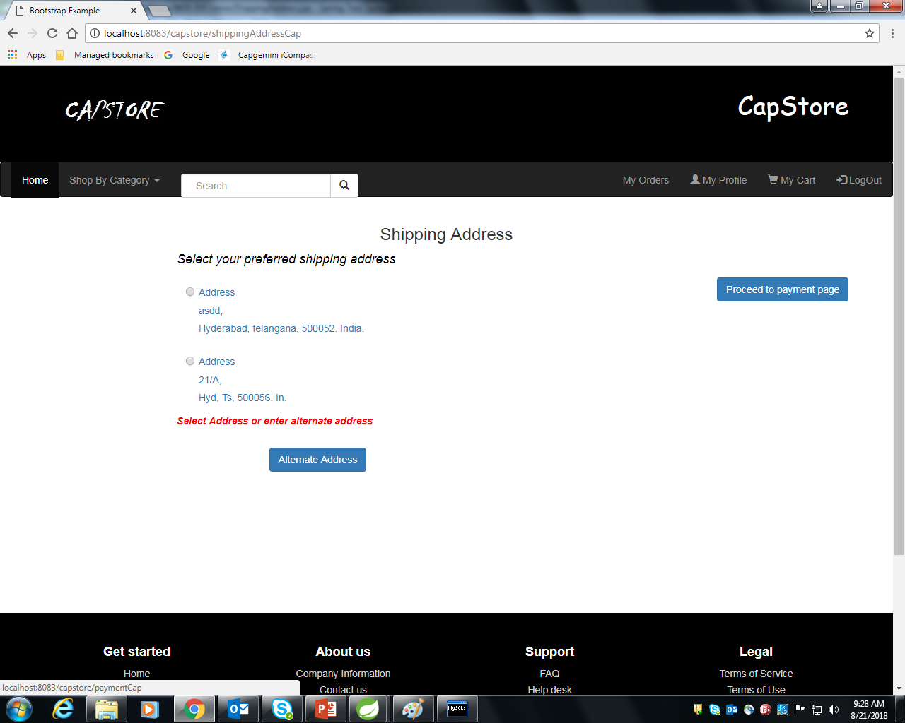

Slide 12
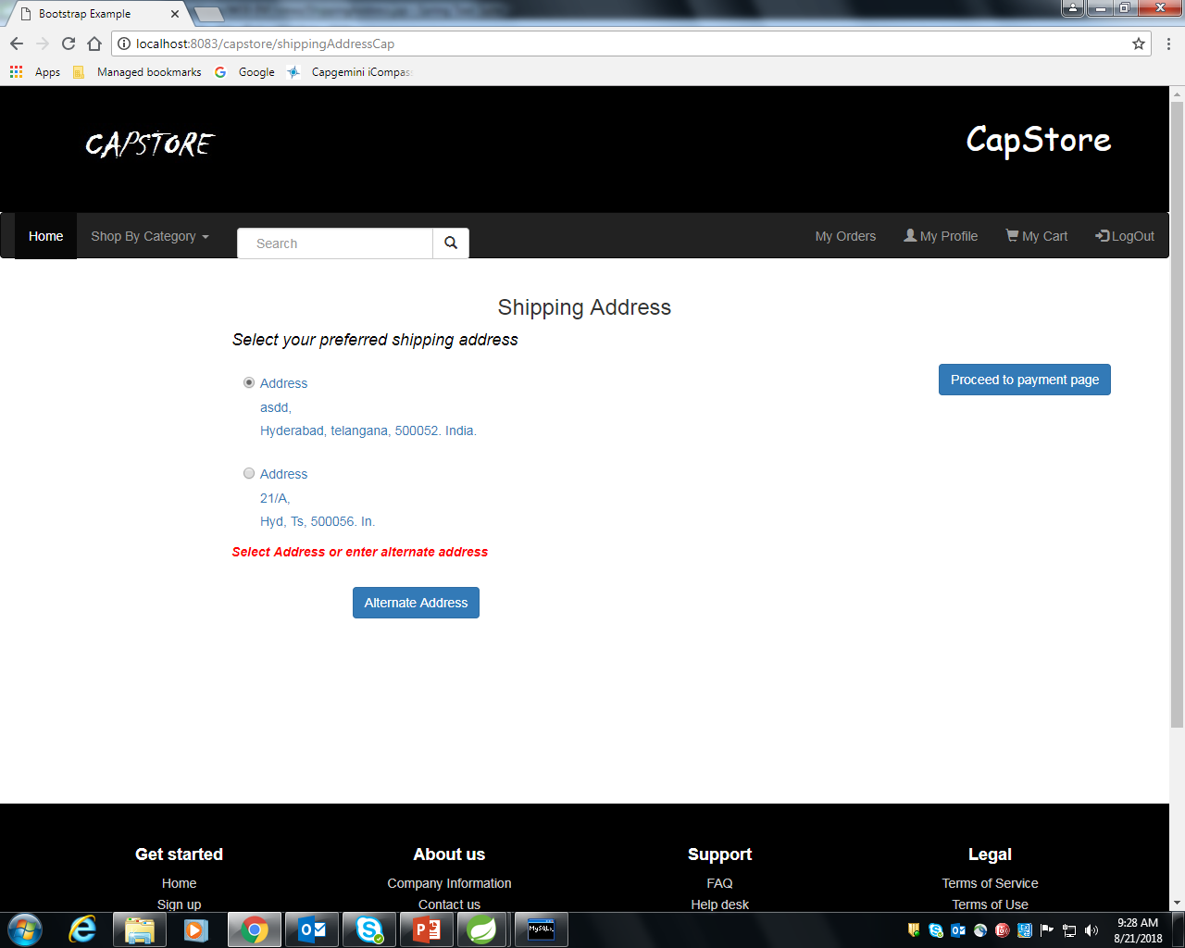

Slide 13
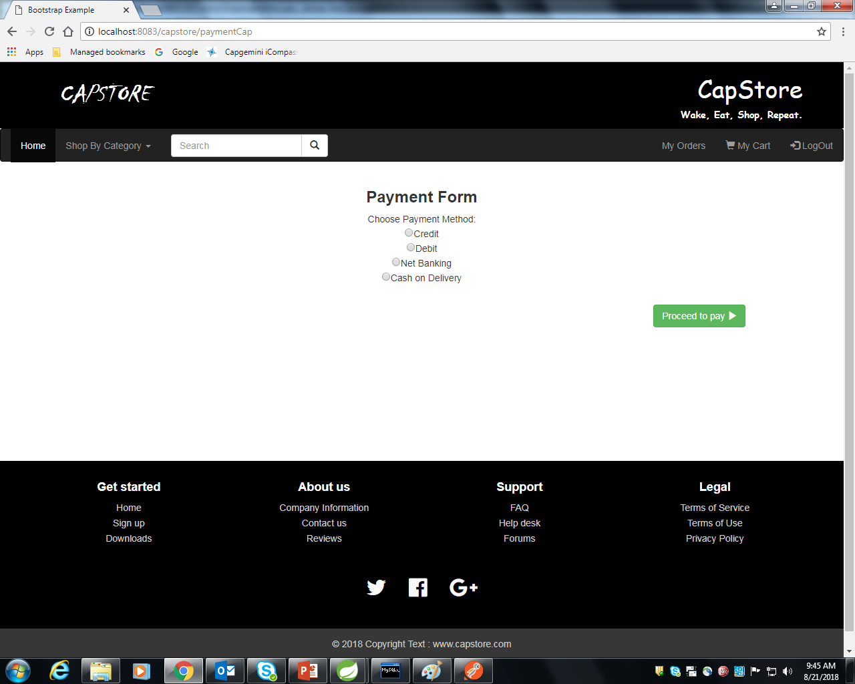

Slide 14
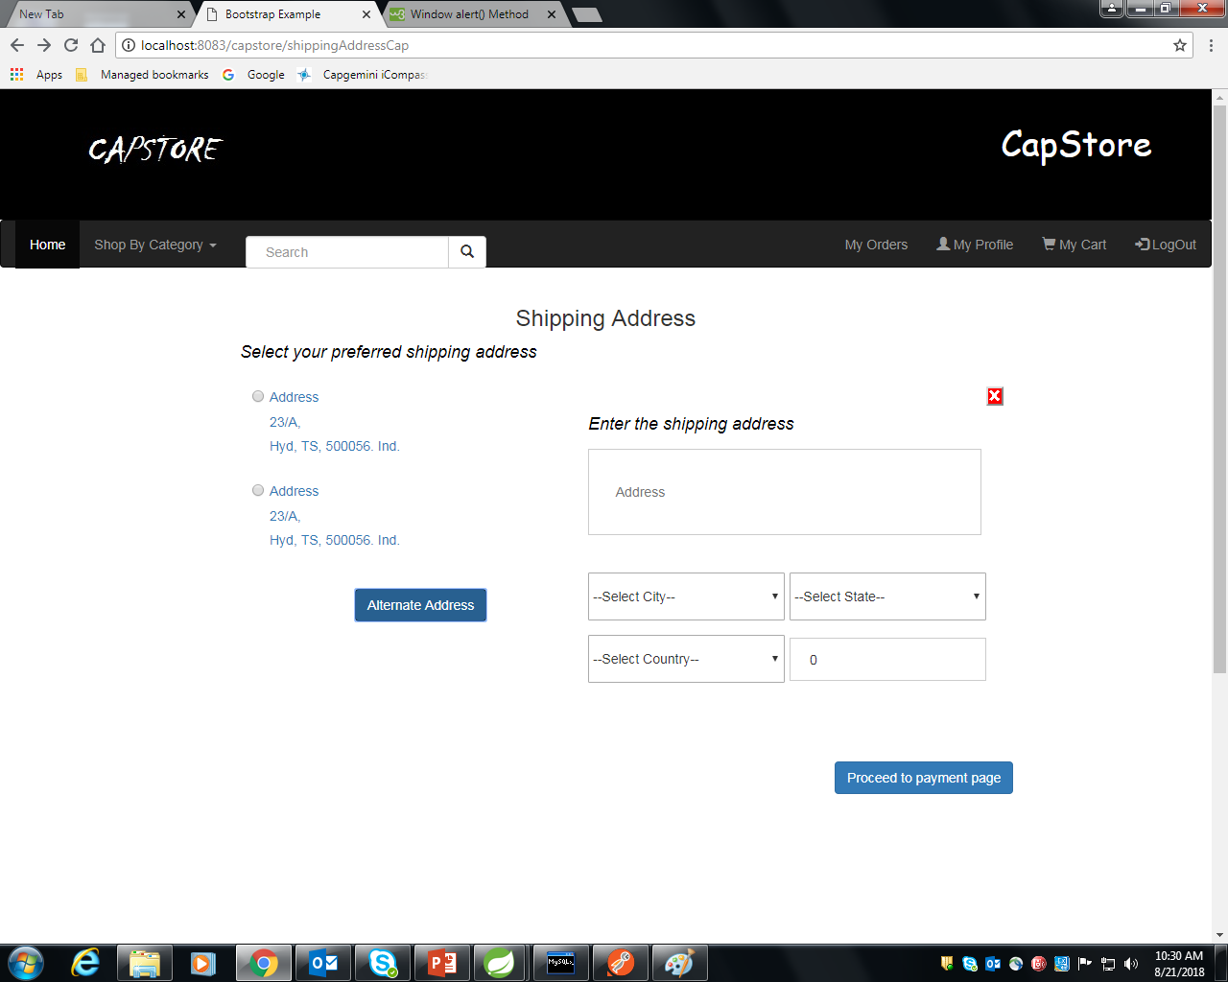

Slide 15
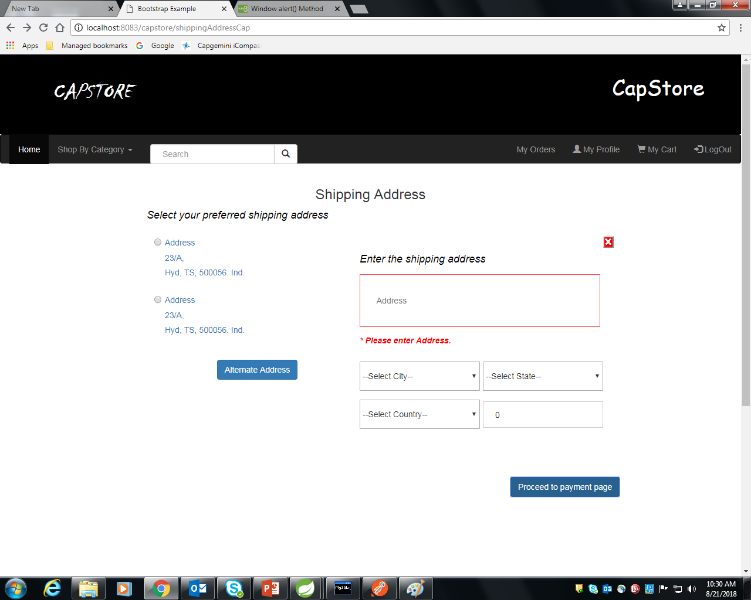

Slide 16


Slide 17
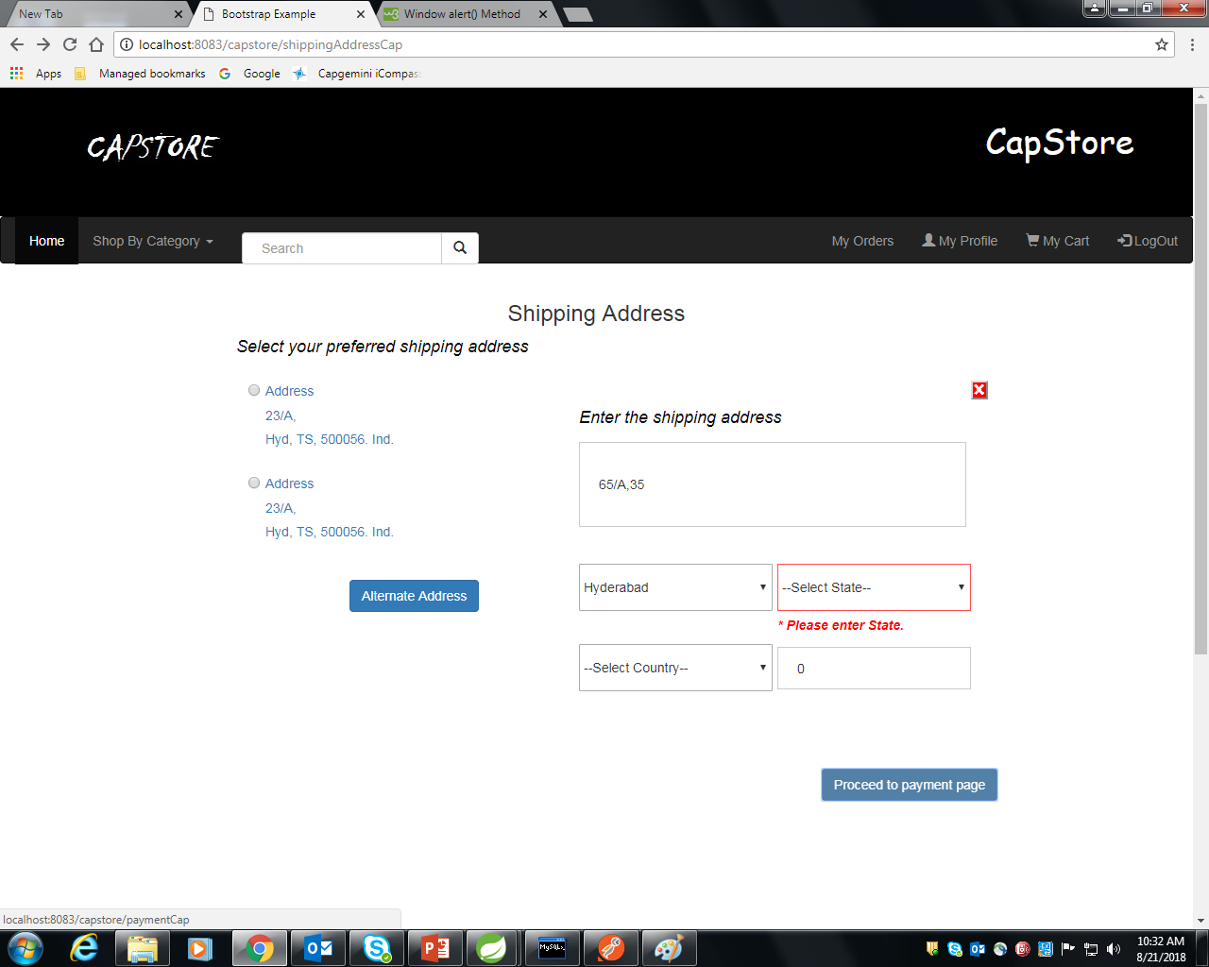

Slide 18
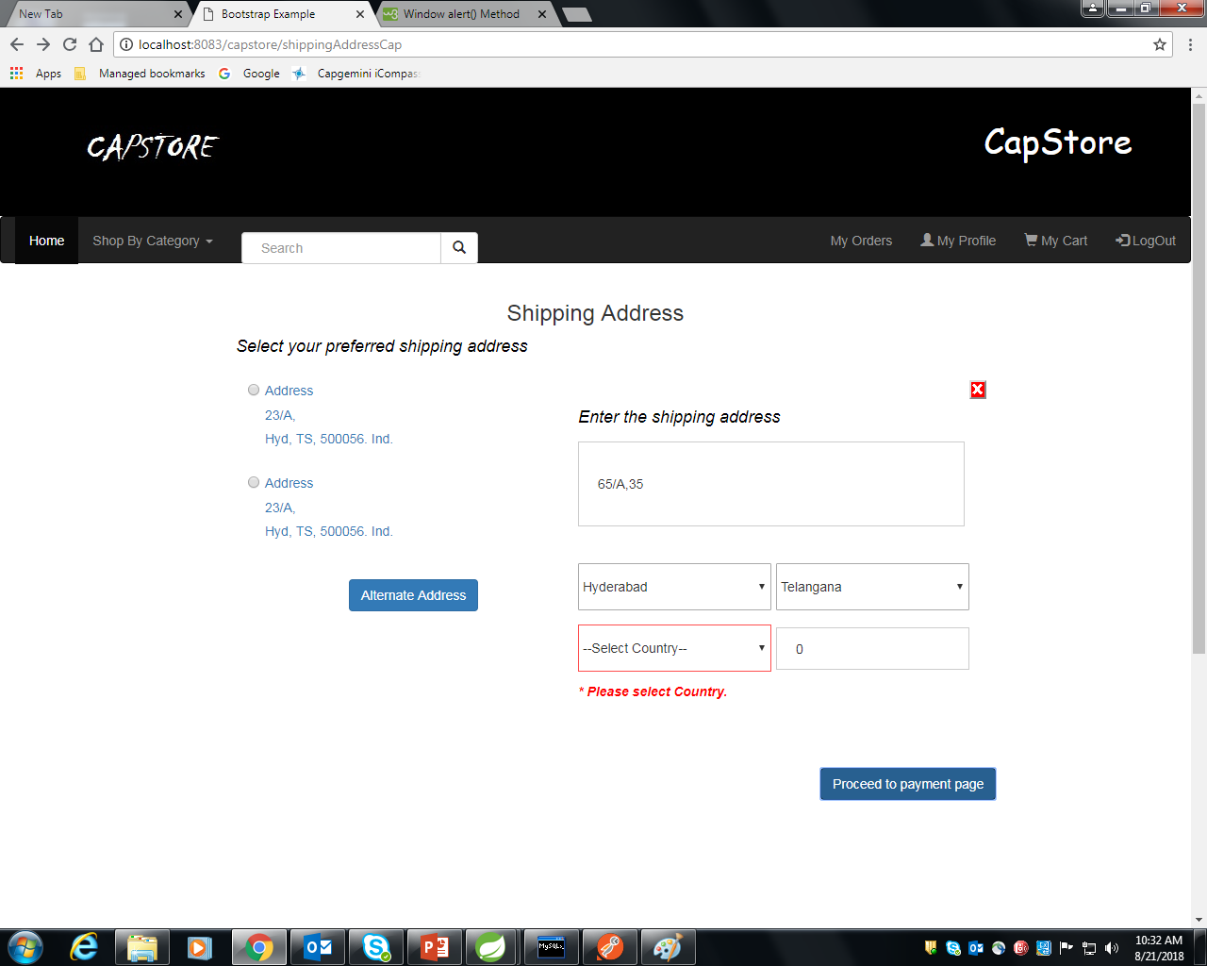

Slide 19
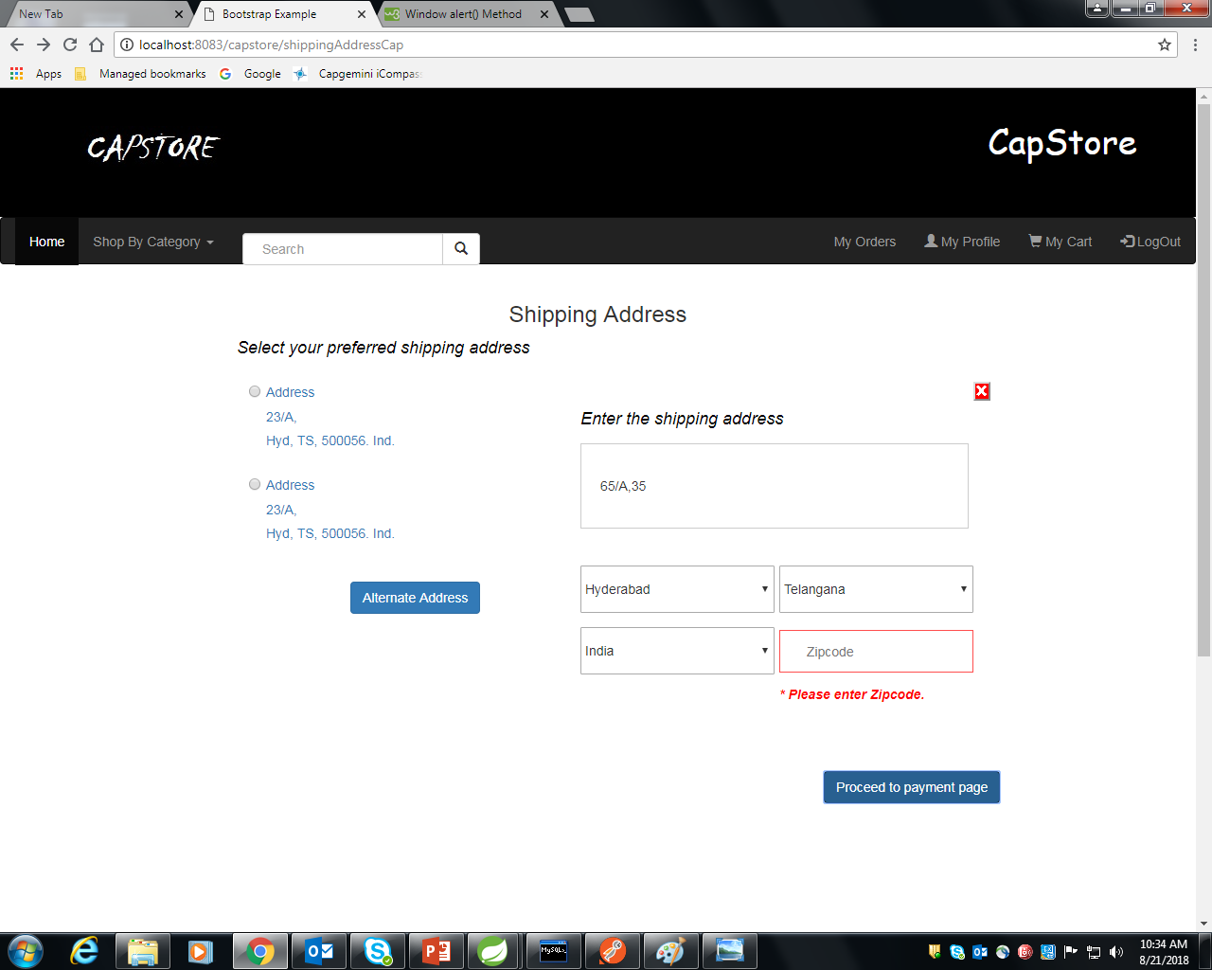

Slide 20
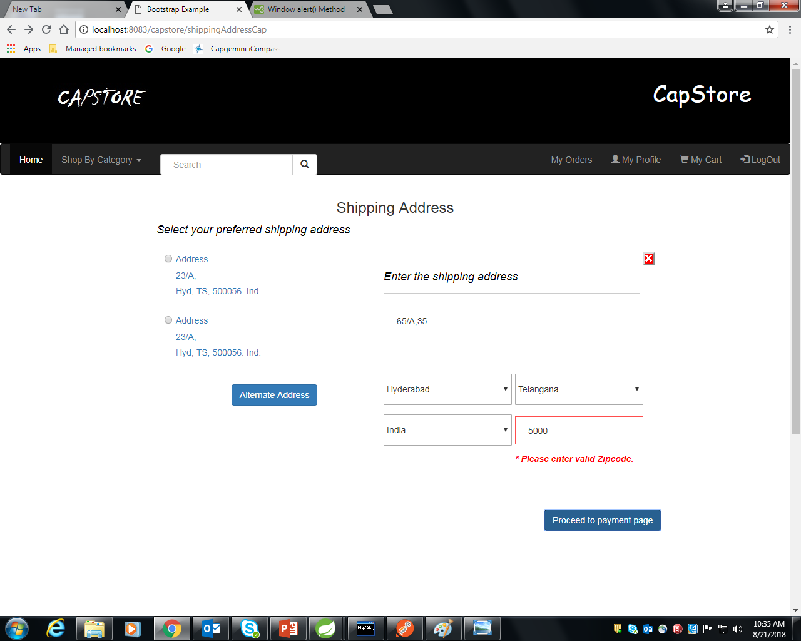

Slide 22
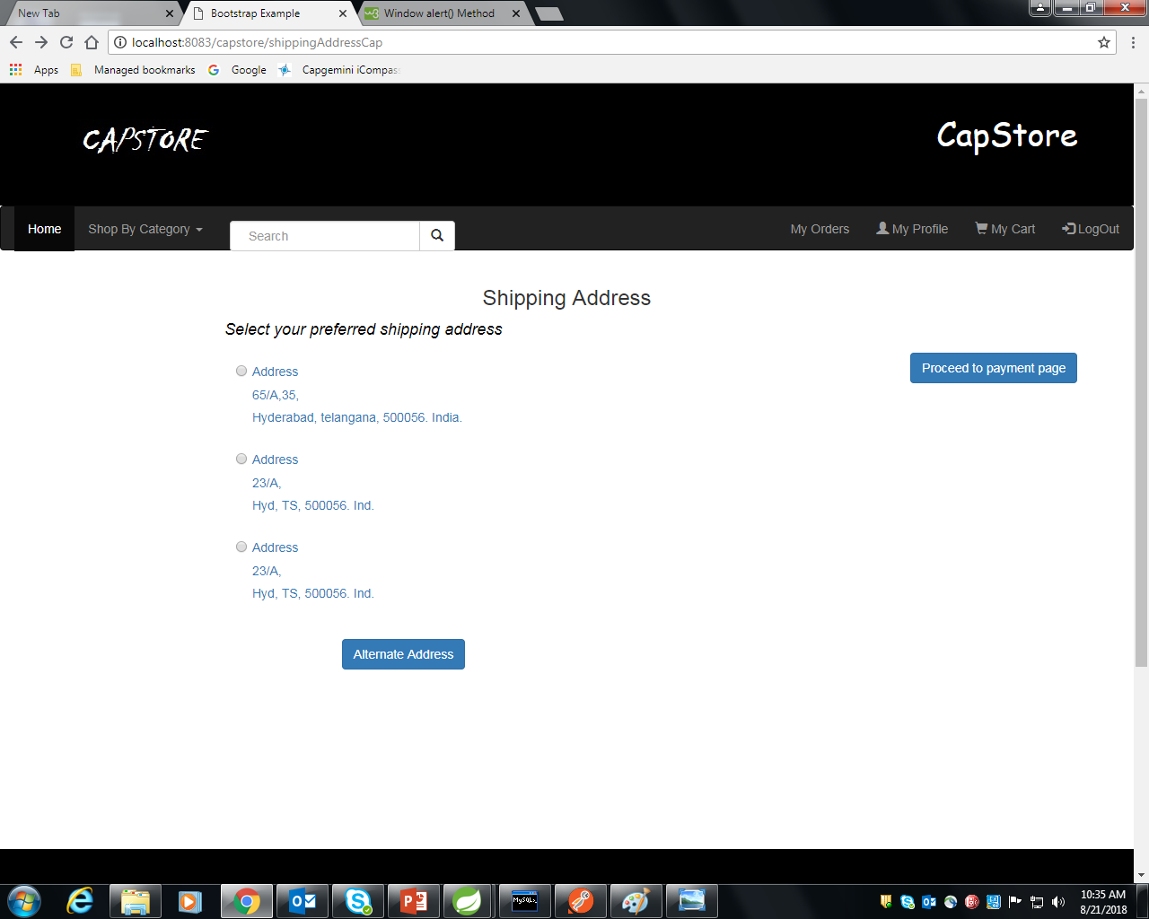

Slide 23
Thank You
Notes:
O Box atras do texto desnecessario. Deixar o layout mais simples.

